Slide 1

DriverPass System Analysis
Nichole Griffith
Notes:
[No speaker notes required for this slide.]

Slide 2

System Requirements
Functional Requirements:
Customers will be able to choose packages, book appointments, and make payments
Trainers will be able to book appointments and review notes for their trainees
Nonfunctional Requirements:
The users will be able to access the system with whichever method they choose (cellphone, laptop, desktop computer, etc.)
Payments will be processed securely
Notes:
The functional requirements for this project were suggested by the owner of DriverPass. Since he will be a user of the system, his input was valuable. The majority of users will be customers and trainees, so I selected these two to showcase the range of functions for these users.
The nonfunctional requirements are needed to facilitate the functional requirements. Security is important to everyone, so I chose to showcase the secure payment method in this slide. Cross-platform capabilities are the best way to ensure the most people can use the system, so I emphasized this here.

Slide 3
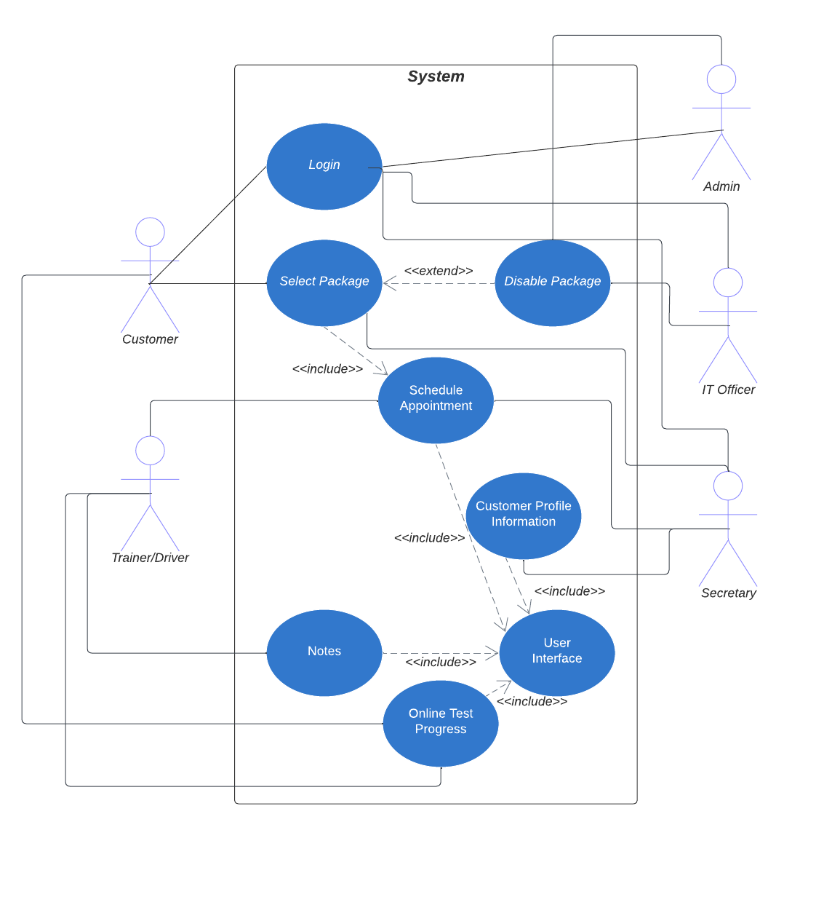
Use Case Diagram
Notes:
The actors interacting with this system are customers, trainers, and various IT users. Customers will have different use-cases for the system than the IT users. All users will be login, of course. Customers will be able to select packages and schedule appointments. Trainers will be able to schedule appointments and manage notes. The secretary will be the liaison for customers looking to sign up with the system, so that use-case will involve managing appointments and user registration. The other IT users will have managing users and updating packages as needed.

Slide 4
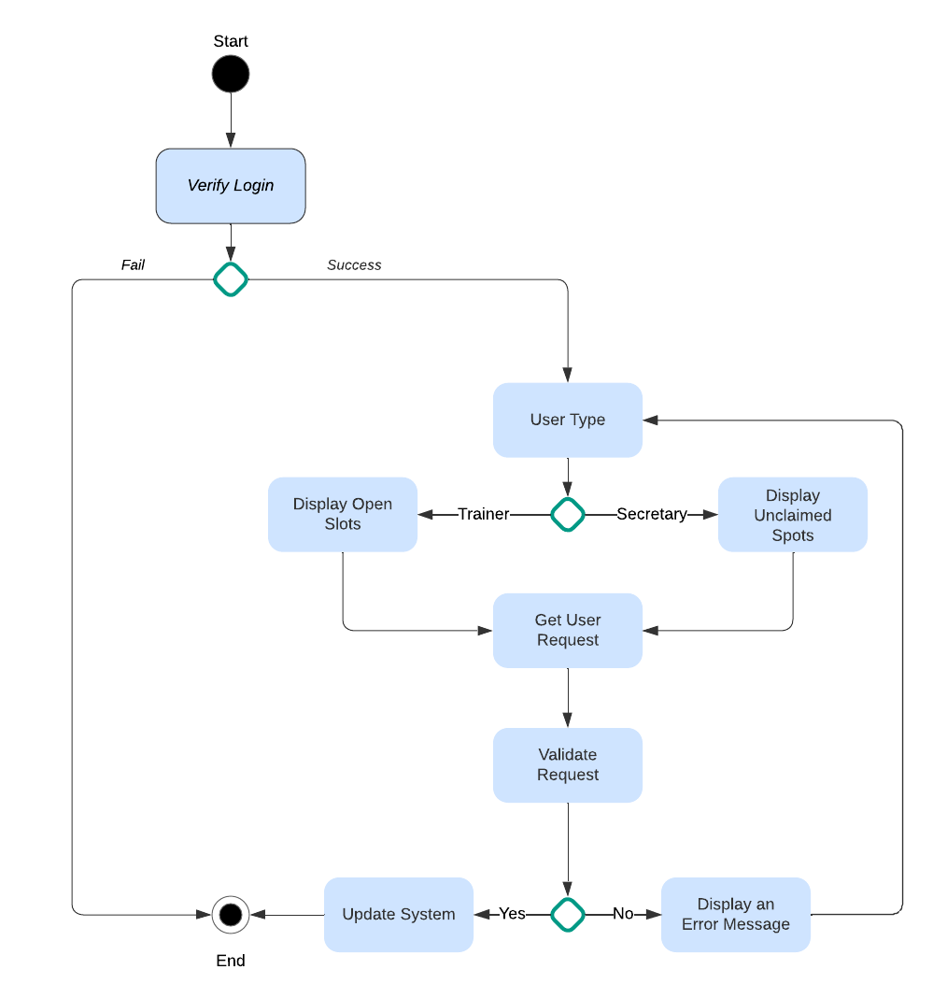
Activity Diagram
Notes:
This diagram shows the activity of scheduling an appointment. The user logs in, the login is verified and either ends or goes to the next step. That next step figures out what type of user it is to determine what appointments to display. Customers will have available slots and trainers will have open slots that need filled. After the choice is made, the system will double-check to ensure it hasn’t overbooked and either go on to update the database or have the user try again.

Slide 5
Security
Outside payment system (such as Square or Paypal) to handle payment transactions securely
SSL encryption to protect data
Self-hosted server to prevent data leaks
Account lock feature to prevent brute force attacks
Notes:
Payment have become increasingly tricky to independently maintain, so we will be using a trusted name to handle our transactions. Since they specialize in payment transactions, they have the best way of doing it securely. SSL encryption is standard these days and customers will feel safer with the little SSL certificate icon next to the URL bar. Self-hosted servers mean that the data is stored locally, not on the cloud. Because there is only one source for the data, it is easier to track the network handling the data. The account lock feature will lock a user’s account if an incorrect password is entered more than three times.

Slide 6
System Limitations
Only serve local customers
Self-hosted means down-time is possible for upgrades and issues
Internet access required
Phone or computer required
Notes:
[What are the limitations of your design? In your explanation, keep your audience in mind by avoiding the use of technical terms.]
To conform with insurance and local laws, we will only be able to serve local customers. Driving test standards can and do vary between states, so it would be impractical at this time to serve customers from other states. Self-hosted servers have the limitation of needing downtime for updates and to address issues. This is in comparison to cloud-based systems which are less susceptible to needing downtime. Internet access is required because the system is web-based. A device such as a phone or a computer will be needed to take advantage of DriverPass.

